Slide 1

HTML Text Formatting

Slide 2
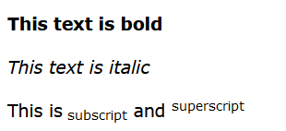
What is text formatting?
In Microsoft Word, for example, there may be occurrences where you need to underline or bold some words to bring emphasise.
Today, we are going to explore some of the ways a developer can bring their message across in a more effective manner using formatting rules.

Slide 3
The list of Formatting Elements
<b> - Bold text
<strong> - Important text
<i> - Italic text
<em> - Emphasized text
<mark> - Marked text
<small> - Smaller text
<del> - Deleted text
<ins> - Inserted text
<sub> - Subscript text
<sup> - Superscript text

Slide 4
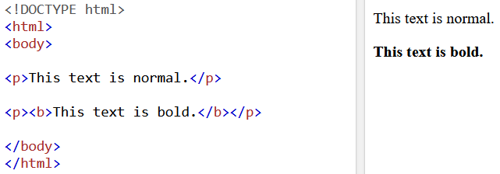
<b> and <strong> element
<b> defines bold text, without extra importance.
<b > defines text, but with strong importance.

Slide 5
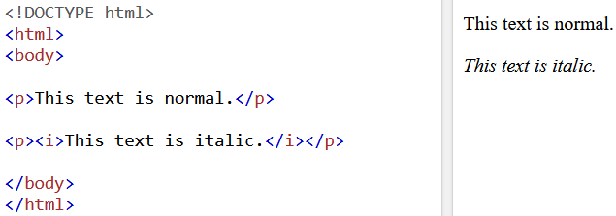
<i> and <em> elements
<i> element defines a part of text im alternate “voice” or “mood”. Text is displayed in italics.
<em> defines an emphasised text. Text is also displaced in italics.

Slide 6
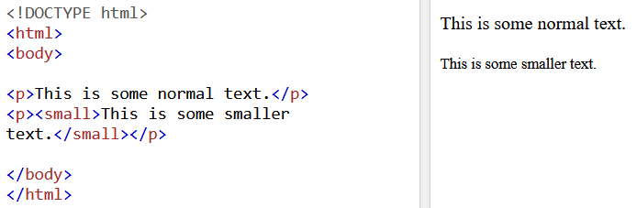
<small> element
Defines some smaller text.

Slide 7
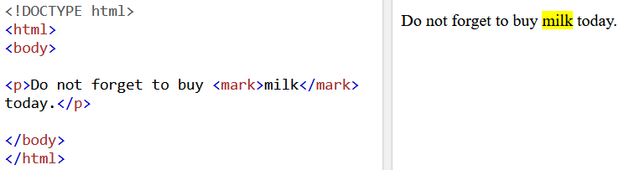
<mark> element
Defines the texts which needs to be highlighted.

Slide 8
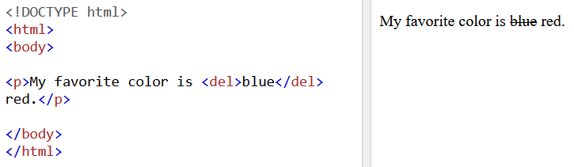
<del> element
Defines text that has been deleted from a document.
It will be displayed a strikethrough.

Slide 9
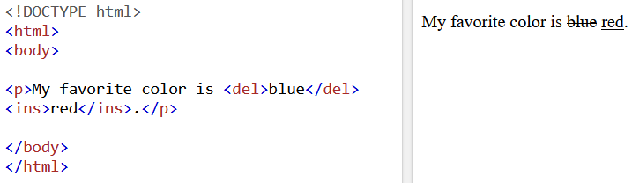
<ins> element
Defines a text that has been inserted into a document.
Browser would display it using an underline.

Slide 10
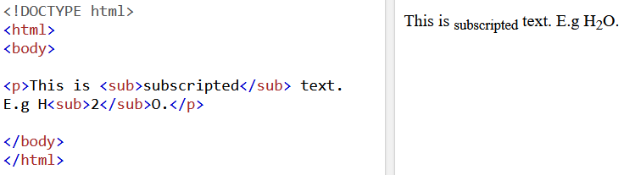
<sub> element
Defines a subscript text.
Text usually appears half a character above the normal line.

Slide 11
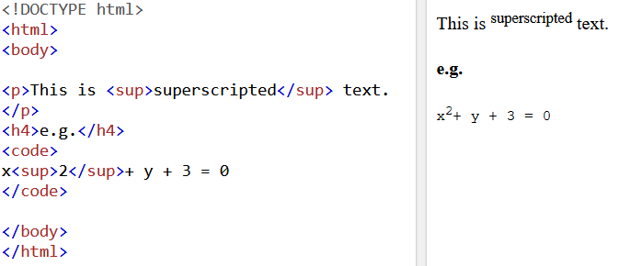
<sup> element
Defines a superscript text.
Text would appear half a character above the normal line.

Slide 12
Task 4
The following quote is from Wikipedia, explaining what Earth is.
Show me your note-taking skills, use whatever we have learnt today to emphasise on important points!
Earth is the third planet from the Sun and the only astronomical object known to harbor life. About 29% of Earth's surface is land consisting of continents and islands. The remaining 71% is covered with water, mostly by oceans but also by lakes, rivers and other fresh water, which together constitute the hydrosphere. Much of Earth's polar regions are covered in ice. Earth's outer layer is divided into several rigid tectonic plates that migrate across the surface over many millions of years. Earth's interior remains active with a solid iron inner core, a liquid outer core that generates Earth's magnetic field, and a convecting mantle that drives plate tectonics.
According to radiometric dating estimation and other evidence, Earth formed over 4.5 billion years ago. Within the first billion years of Earth's history, life appeared in the oceans and began to affect Earth's atmosphere and surface, leading to the proliferation of anaerobic and, later, aerobic organisms. Some geological evidence indicates that life may have arisen as early as 4.1 billion years ago. Since then, the combination of Earth's distance from the Sun, physical properties and geological history have allowed life to evolve and thrive. In the history of life on Earth, biodiversity has gone through long periods of expansion, occasionally punctuated by mass extinctions. Over 99% of all species that ever lived on Earth are extinct. Almost 8 billion humans live on Earth and depend on its biosphere and natural resources for their survival. Humans increasingly impact Earth's hydrology, atmospheric processes and other life.

